Slide 1
How to run Graphics using “graphics.h” in Dev C++ in Windows 7
Sourav Biswas
sb_says@rediffmail.com

Slide 2
Files Required
Latest Dev C++ version: Dev-C++ 5.0 beta 9.2 (4.9.9.2) (9.0 MB) with Mingw
WinBGIm-6.0-1g17l.DevPak
graphics.h (modified)
libbgi.a (modified)

Slide 3
Place the files in their proper locations
Install WinBGIm-6.0-1g17l.DevPak
graphics.h to C:\Dev-Cpp\include
libbgi.a to C:\Dev-Cpp\lib

Slide 4
Dev C++ tweaks for Windows 7
Goto Tools > Compiler Options, move on Directories tab and add C:\Dev-Cpp\libexec\gcc\mingw32\3.4.2 to Binaries
Goto programs and put C:\Dev-Cpp\bin\ before any executable name
Goto Settings tab > Linker and change Generate debugging information to “Yes"

Slide 5
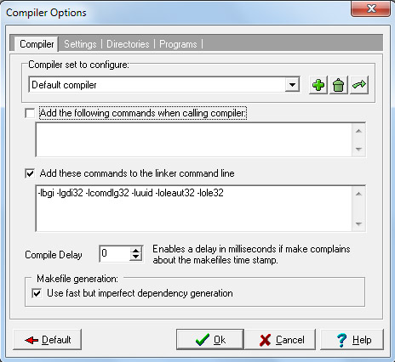
Linking
Goto Tools > Compiler Options
Insert the following text in the linker field
-lbgi -lgdi32 -lcomdlg32 -luuid -loleaut32 -lole32

Slide 6
Linking (contd.)
Goto Tools > Editor Options > Class browsing.
Check Scan local files referenced in #include’s.
Check Scan global files referenced in #include’s.
Then click on Completion and then click on OK.
Check the Windows System Path and include C:\Dev-Cpp\bin;C:\Dev-Cpp\lib; if not present.
Restart the system.

Slide 7
Ready to Run
Create new project
Add new source file
Write your graphics codes
Compile and Run
And have FUN ……

Slide 8

This is the END of the BEGINNING

